Slide 1
Weather App
Team Details:
Japish Bagga -2210990432
Jatin Kumar -2210990459
Kartik Sharma -2210990489
Arushi Chawla -2210990999
Faculty Coordinator: Dr. Baljit Kaur, Mr. Vikas Patel

Slide 2
Table of Contents
Introduction
Problem Statement
Technical Details
Key Features
Project Highlights
Conclusion
References/Links used

Slide 3
Introduction
In this project, our primary goal is to craft a state-of-the-art weather application leveraging the robust capabilities of the React.js framework. Our vision is to redefine how users engage with weather forecasts, offering them an unmatched experience that seamlessly combines accessibility, accuracy, and simplicity.

Slide 4
Problem Statement
In today's dynamic world, individuals are increasingly dependent on weather applications to stay informed about atmospheric conditions and plan their activities accordingly. However, many existing weather platforms lack the sophistication to deliver a seamless and personalized experience that aligns with the diverse needs of users. There exists a significant opportunity to develop an advanced weather application that not only simplifies access to forecasts but also enriches user interaction and satisfaction.

Slide 5
Understanding the User Experience:
Central to our development approach is a profound comprehension of user requirements and inclinations. We acknowledge that contemporary users prioritize ease of use and diversity, and our application will address these demands by providing a comprehensive range of weather information and features, all readily accessible at their fingertips.

Slide 6
Key Features
User-Centric Design: Our weather app boasts an intuitive interface, enabling effortless navigation through forecasts, detailed weather information, and customizable settings.
Personalized Forecasting: Utilizing advanced algorithms, the app offers tailored weather predictions based on user location, historical data, and individual preferences.
Real-Time Updates: Users receive instant updates on current weather conditions, forecasts, and alerts, ensuring they stay informed and prepared.
Seamless Integration: The app seamlessly integrates with other platforms and devices, providing a cohesive weather tracking experience across multiple channels.
Customizable Features: Users can personalize their weather dashboard, selecting preferred metrics, display options, and location-based settings.

Slide 7
Tech Stack:
HTML, CSS, and JavaScript: These foundational technologies will be utilized to structure, style, and add interactivity to the weather app's user interface, ensuring a seamless and visually engaging experience for users.
React.js: Leveraging the power of React.js for frontend development will enable the creation of dynamic and responsive user interfaces. Its component-based architecture will facilitate efficient management of weather components and state, enhancing user interaction and usability.
API Integration: External APIs will be integrated to augment the app's capabilities. This includes incorporating geolocation services to provide personalized weather forecasts based on the user's location, as well as accessing reliable weather data sources to ensure accuracy and timeliness. Additionally, integration with payment gateways can be considered for premium features or subscriptions, allowing users to access advanced functionalities.
Continuous Improvement: Regular updates and improvements will be implemented based on user feedback and technological advancements, ensuring the weather app remains relevant, reliable, and user-friendly.

Slide 8
Project Highlights
Interactive User Experience: Utilizing React.js for an engaging user interface, enabling seamless browsing and ordering.
Stylish Design: Employing CSS for an attractive and visually appealing layout.
Structured HTML: Organizing the page layout for easy navigation and accessibility.
Search with API Integration: Implementing JavaScript for a powerful search feature, fetching real-time data for accurate results.
Personalized Recommendations: Providing tailored suggestions based on user preferences and history.
Real-Time Order Tracking: Enabling users to track orders from confirmation to delivery for transparency.
Secure Payment Integration: Integrating secure payment gateways for smooth transactions.
Accessibility: Ensuring accessibility features for all users' convenience and inclusivity.

Slide 9
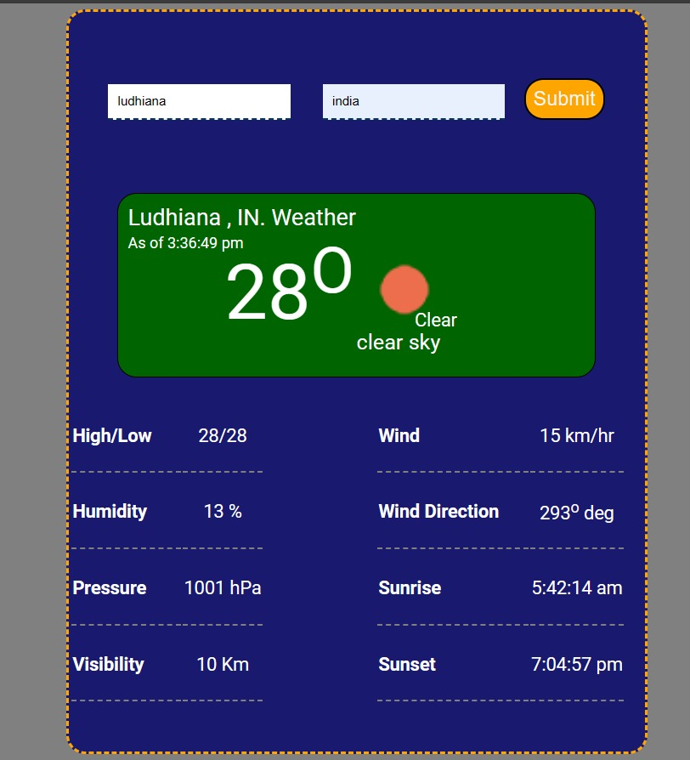

Slide 10
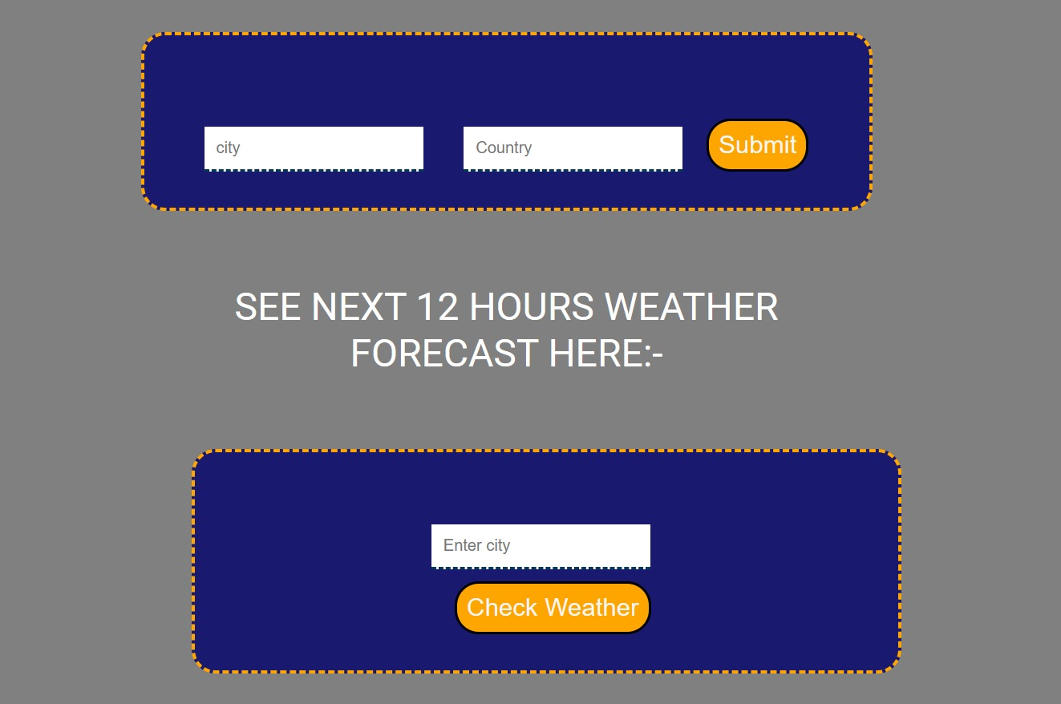
Menu page

Slide 11
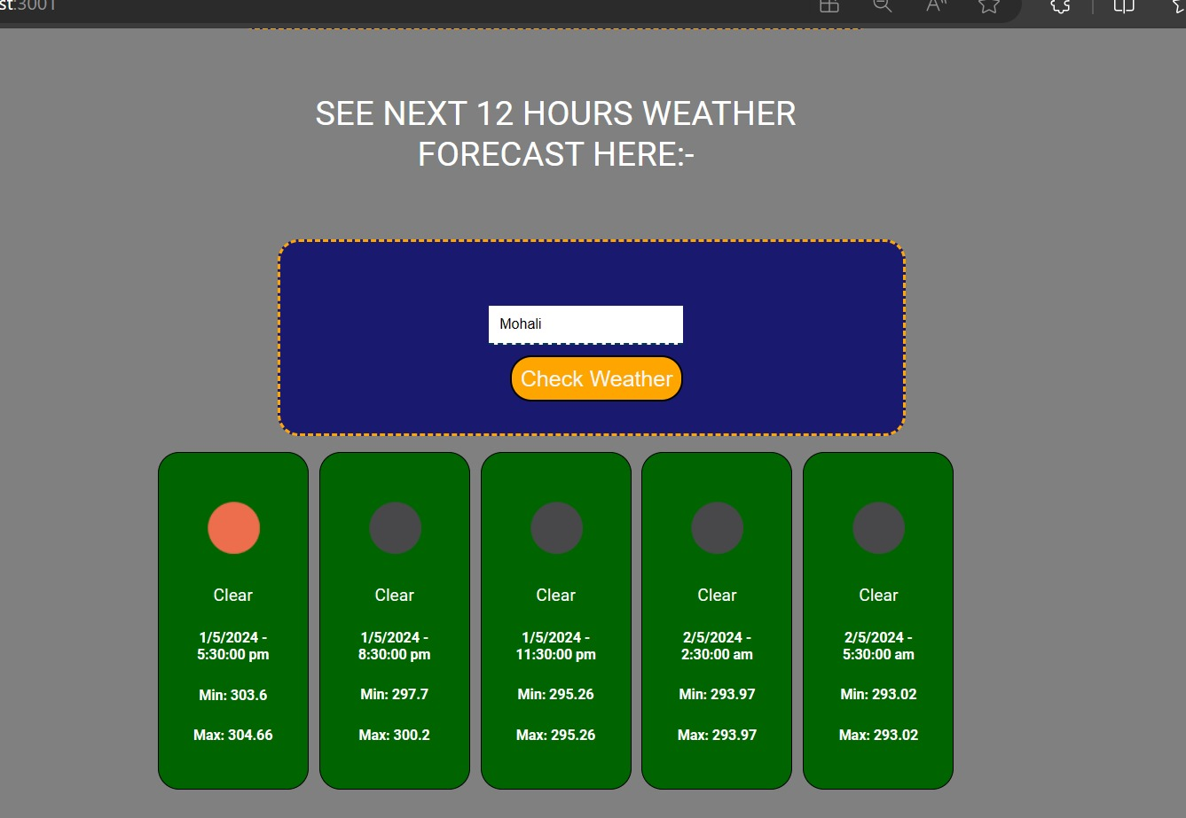

Slide 12
Conclusion:
Join us on this journey as we embark on the development of "Luminate Weather" — a revolutionary weather application poised to redefine how individuals engage with meteorological forecasts, one forecast at a time.

Slide 13
References/Links used
MDN Web Docs - https://developer.mozilla.org/enUS/docs/Web
W3Schools - https://www.w3schools.com/
CSS-Tricks - https://css-tricks.com/
Codecademy -https://www.codecademy.com/
Stack Overflow - https://stackoverflow.com/

Slide 14


